Slide 1
Transverse Wave Motion part 2
21st September 2020

Slide 2
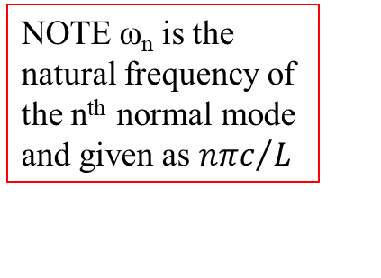
Standing waves on a string of a fixed length
The displacement on the string at any point is given by
With the boundary condition that y = 0 at x = 0 and x = l at all times, thus
The complete expression for the displacement of the nth harmonic is given by
This may be expressed as
Where the amplitude of nth mode is given by
NOTE ω_{n} is the natural frequency of the n^{th} normal mode and given as ${nπc}/L$
Notes:
Because ω_{n} = k_{n}c and from 2nd bc k_{n}l =n$π$, therefore ω_{n} = nπc /l
The natural frequencies will be higher if the string is shorter, or if the tension is higher, or if the density is lower. The natural (or allowed) frequencies are integer multiples of the fundamental (n=1) frequency.

Slide 3
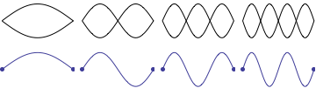

Normal mode condition
Due to the second boundary condition: y = 0 at x = l at all times, $kl=nπ.$
This leads to $l={nλ}/2$ which is the condition for each normal mode of standing waves.
The animation below shows the first four allowed mode shapes for a fixed-fixed string. The number of "humps" (antinodes) corresponds to the value of n.
l
l
l
l
https://www.acs.psu.edu/drussell/Demos/Pluck-Fourier/Pluck-Fourier.html

Slide 4
Energy of each normal modes of vibrating string
The energy in each harmonic is composed of kinetic and potential energy.
Where
Notes:
This has to be considered the unit length.

Slide 5
Standing Wave Ratio (SWR)
If a progressive wave system is partially reflected from a boundary, the incident and reflected amplitudes partially cancel out.
In this case the ratio of maximum to minimum amplitudes in the standing wave system is called
Where : the magnitude of the amplitude ratio;
Since
SWR is always greater than or equal to unity and can be used to determine the sample’s reflection coefficient (r), its absorption coefficient (α) and its impedance (Z).
NOTE : A₁ = incident amplitude
B₁ = reflected amplitude

Slide 6
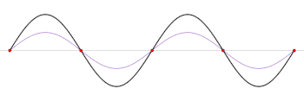
Standing wave ratio and reflection coefficient
A₁+B₁ = 2 times amplitude
A₁-B₁ = 0
Incident wave is fully reflected out of phase at both ends, creating a (black) standing wave. r = −1, SWR = ∞
What is an application of SWR?
https://en.wikipedia.org/wiki/Standing_wave_ratio
Notes:
This means the material fully reflects the incident wave. No absorption

Slide 7

Example 1
Finding the superposition of given travelling waves on a string which is fixed at both ends.
$y_{1}\left(x,t\right)=A\cos\left(ωt−kx\right)$ and $y_{2}\left(x,t\right)=rA\cos\left(ωt+kx\right)$ : where r is the coefficient of amplitude reflection.
Note that the superposition of the travelling waves represents the displacement of a wave on the string.

Slide 8
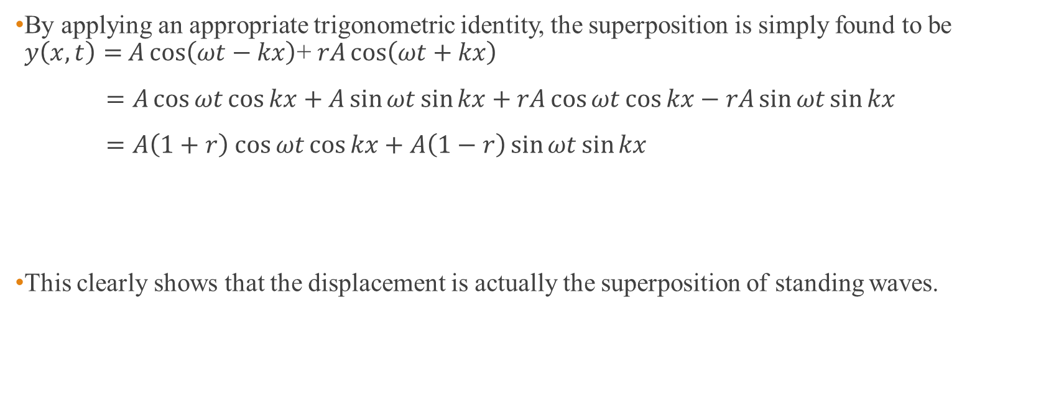
Solution
By applying an appropriate trigonometric identity, the superposition is simply found to be $y\left(x,t\right)=$ $A\cos\left(ωt−kx\right)$+ $rA\cos\left(ωt+kx\right)$
$=A\cos{ωt}\cos{kx}+A\sin{ωt}\sin{kx}+rA\cos{ωt}\cos{kx}−rA\sin{ωt}\sin{kx}$
$=A\left(1+r\right)$ $\cos{ωt}\cos{kx}+A\left(1−r\right)\sin{ωt}\sin{kx}$
This clearly shows that the displacement is actually the superposition of standing waves.

Slide 9
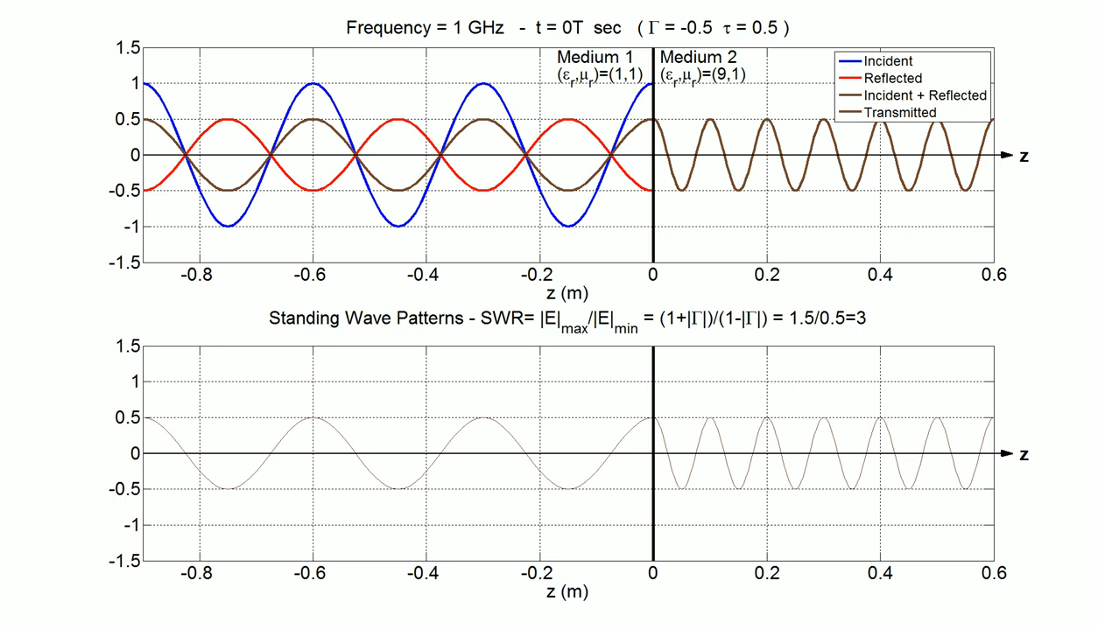
Example 2
https://www.youtube.com/watch?v=s5MBno0PZjE

Slide 10
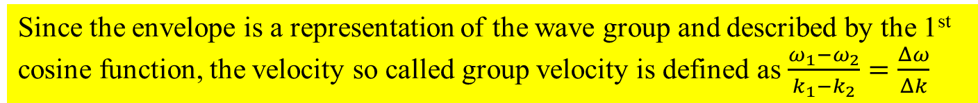
Wave group
Superposition of two travelling waves of almost equal frequencies;
Superposition of amplitude and phase gives
V_{g}= group velocity
V_{p}= phase velocity
Since the envelope is a representation of the wave group and described by the 1st cosine function, the velocity so called group velocity is defined as $\frac{ω_{1}−ω_{2}}{k_{1}−k_{2}}=\frac{Δω}{Δk}$
Notes:
In this case, the travelling wave involved are right moving sinusoidal waves with unequal frequencies.
Vg velocity at which the envelope of wave peaks move
Vp velocity at which successive peaks move

Slide 11
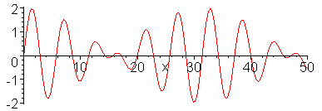
Group velocity
Consider 2 cases which are the same phase velocities and different phase velocities.
(1) The two waves have the same phase velocities; i.e., ω₁/k₁ = ω₂/k₂ = c. This leads to
This suggests that the component frequencies and their superposition, or group will travel
with the same velocity, the profile of their combination remaining constant.
This situation, i.e. v_{g} = v_{p} , is for non-dispersive waves.
http://physics.usask.ca/~hirose/ep225/animation/dispersion/anim-dispersion.html
Notes:
The same phase velocity means every wave in the group propagates with the same velocity.
The velocity of the envelope represents the group velocity.
As can be seen from the animation, there is no relative motion between the envelope and the internal component is

Slide 12
Revisit the superposition of two waves of almost equal frequencies
The superposition produces an amplitude which varies between 2a and 0.
This situation is called complete or 100% modulation.
The high frequency wave is amplitude modulated.
This actually is an example of sent signal found in a communication technique for transmitting information.

Slide 13
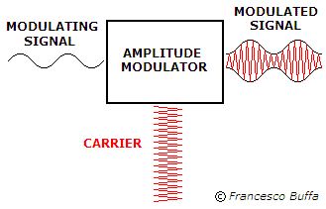
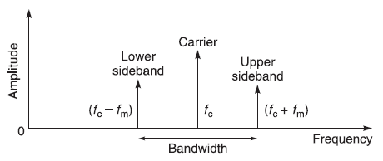
Amplitude Modulation (AM)
ω/
A general expression of an amplitude modulated wave is given as
Where the modulated amplitude
This gives
Two new frequencies (sidebands) are introduced.
ω
ω-ω’
ω
ω+ω’
https://dsp.stackexchange.com/questions/47604/when-listening-in-to-an-am-signals-of-various-frequencies-how-do-we-exactly-tun
https://giphy.com/gifs/analog-BzYOp24AXnHEI
Notes:
Amplitude modulation of a carrier frequency is a common form of radio transmission, but its generation of sidebands has led to the crowding of radio frequencies and interference between stations.
Using 2cos a cos b = cos(a+b) + cos(a-b)

Slide 14
Group velocity (contd.)
(2) Two frequencies components have different phase velocities so that ω₁/k₁ ≠ ω₂/k₂.
The group velocity is given as
  The superposition of the two waves will no longer remain constant and the group profile will change with time.
  If a group contains a number of components of frequencies which are nearly equal, the original expression for the group velocity is written
This situation, i.e. v_{g} ≠ v_{p} , is for dispersive waves.

Slide 15
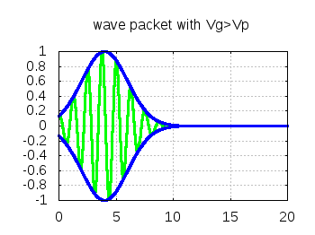

Dispersion relation
A medium at which the phase velocity is frequency dependent (ω/k not constant) is known as a dispersive medium and a dispersion relation expresses the variation of ω as a function of k.
This leads to three possible changes with time of the group velocity profile relative to the phase velocity.
They include
(1) v_{g} = v_{p} : a non-dispersive relation
(2) v_{g} < v_{p} : a normal dispersion relation
(3) v_{g} > v_{p} : an anomalous dispersion relation
http://theory.ipp.ac.cn/~yj/free_software.html

Slide 16
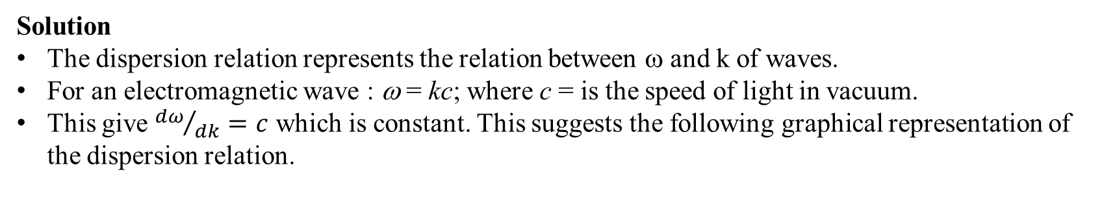
Example 3
Draw a dispersion relation of electromagnetic waves in vacuum.
Solution
The dispersion relation represents the relation between ω and k of waves.
For an electromagnetic wave : ω = kc; where c = is the speed of light in vacuum.
This give ${dω}/{dk}=c$ which is constant. This suggests the following graphical representation of the dispersion relation.
ω
k

Slide 17
Illustration of dispersion relation
Since ω = kv; v = phase velocity
This term can be either positive or negative.
= Slope of dispersion relation
↑ v ↑ : v_{g} < v (normal dispersion)
↑ v ↓ : v_{g} > v (anomalous dispersion)
Notes:
For normal dispersion ความยาวคลื่นยิ่งยาว ความเร็วยิ่งมาก คลื่นความยาวคลื่นยาววิ่ง “เร็ว” กว่าคลื่นความยาวคลื่นสั้น (v > vg)
For anomalous dispersion ความยาวคลื่นยิ่งยาว ความเร็วยิ่งน้อย คลื่นความยาวคลื่นยาววิ่ง “ ช้า “กว่าคลื่นความยาวคลื่นสั้น (v < vg)
Dispersion relation เป็นกราฟระหว่าง ω และ k
Due to dv/dk = (dv/dλ)(dλ/dk) ---(1)
And k = 2π/λ;∴dk/dλ=-2π/λ² ---(2)
Substitute (2) in (1) we have kdv/dk = -λdv/dλ #

Slide 18
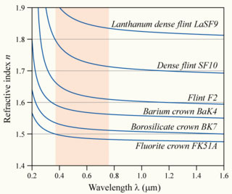
The dependence of refractive index to wavelength for various glasses
Are these various types of glasses non dispersive, normal dispersive or anomalous dispersive?
These are dispersive media because the phase velocity of each wavelength is not equal. This can be seen from the wavelength dependent refractive index.
Also, longer wavelengths move faster than shorter wavelength. This dispersive medium is categorized as the normal dispersive medium.
http://microscopy.berkeley.edu/courses/tlm/optics/chromatic.html
Notes:
They are normal dispersive because longer wavelengths have higher speeds than the shorter wavelengths.
In other words, dv/dλ > 0 and this corresponds to the condition of normal dispersive medium.

Slide 19
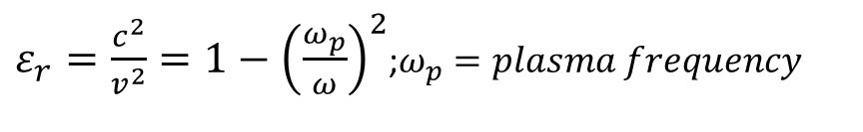

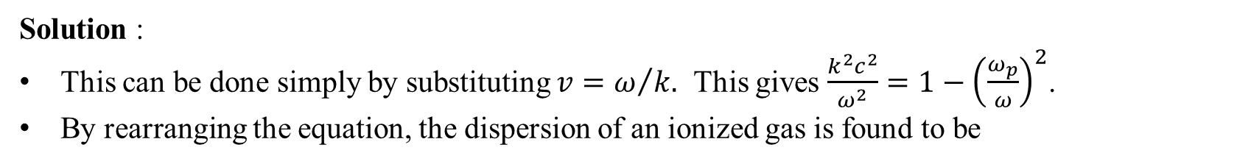

Example 4
It was found previously that the relative permittivity of an ionized gas is given by
This indicates that the relative permittivity is a function of frequency.
Show that the dispersion relation is given as
$ε_{r}=\frac{c^{2}}{v^{2}}=1−{\left(\frac{ω_{p}}{ω}\right)}^{2}$;$ω_{p}=plasma frequency$
$$ω^{2}=ω_{p}^{2}+c^{2}k^{2}$$
Solution :
This can be done simply by substituting $v=ω/{k.}$ This gives $\frac{k^{2}c^{2}}{ω^{2}}=1−{\left(\frac{ω_{p}}{ω}\right)}^{2}$.
By rearranging the equation, the dispersion of an ionized gas is found to be
$$ω^{2}=ω_{p}^{2}+c^{2}k^{2}$$
Notes:
By changing the frequency of the applied em, the refractive index n (=(εr)^1/2) and impedance (z= (ε/μ)^1/2) are also changed)

Slide 20
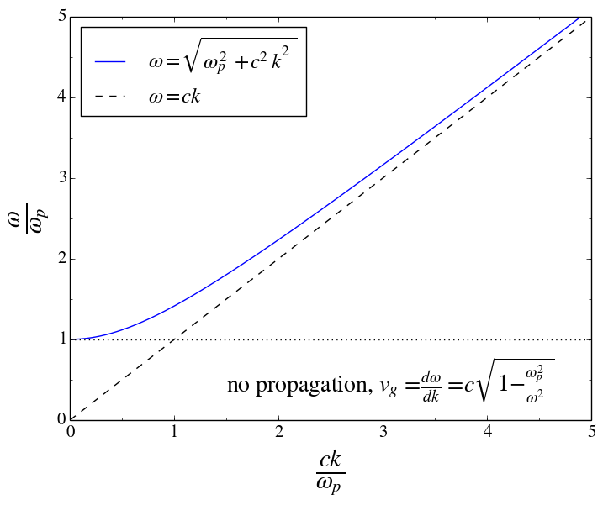

The dispersion relation for EM waves in a plasma
What happens when $\frac{ω}{ω_{p}}<1?$
Solution:
EM waves with frequencies ω less than ω_{p} are attenuated as they propagate through a medium.
https://physics.stackexchange.com/questions/366858/what-is-the-physics-behind-the-plasma-frequency

Slide 21
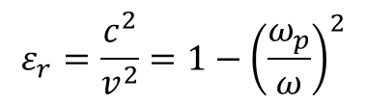
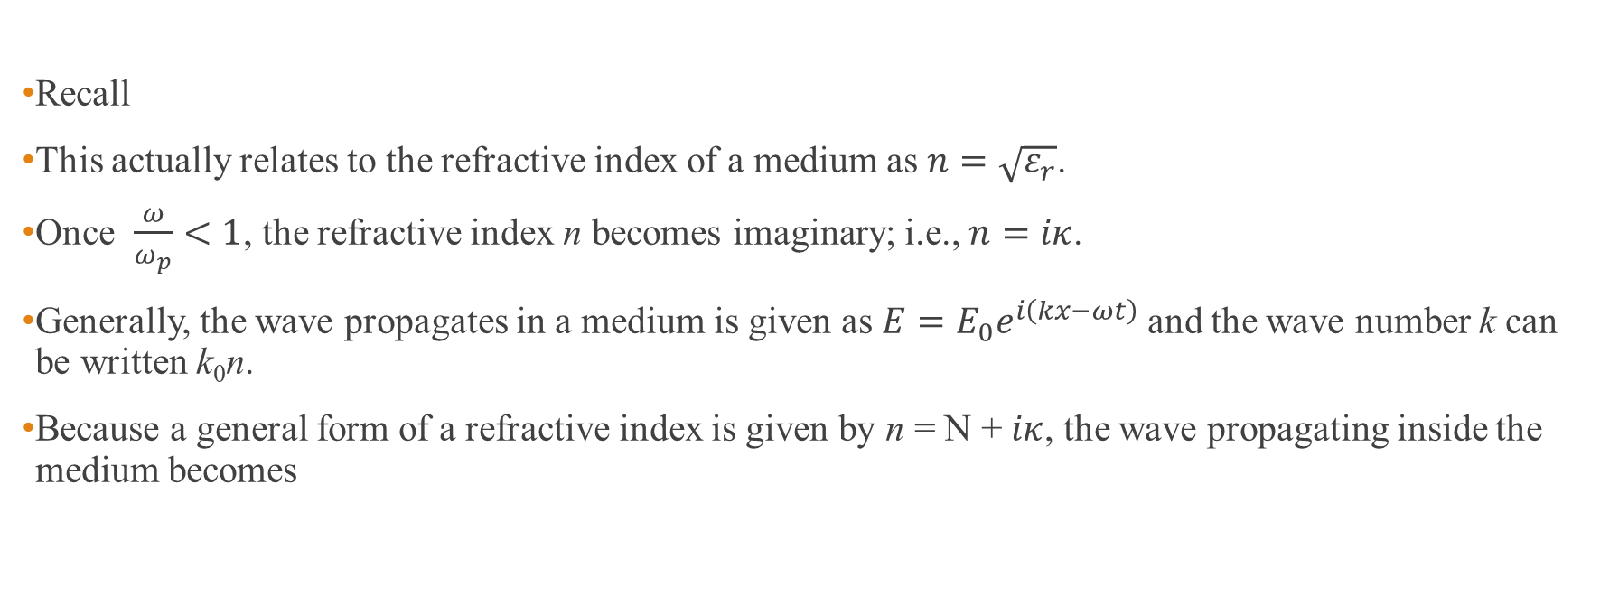
Additional explanation
Recall
This actually relates to the refractive index of a medium as $n=\sqrt{ε_{r}}$.
Once $\frac{ω}{ω_{p}}<1$, the refractive index n becomes imaginary; i.e., $n=iκ$.
Generally, the wave propagates in a medium is given as $E=E_{0}e^{i\left(kx−ωt\right)}$and the wave number k can be written k₀n.
Because a general form of a refractive index is given by n = N + $iκ$, the wave propagating inside the medium becomes
$$ε_{r}=\frac{c^{2}}{v^{2}}=1−{\left(\frac{ω_{p}}{ω}\right)}^{2}$$
$E=E_{0}e^{i\left(kx−ωt\right)}=E_{0}$ $e^{−κx} e^{i\left(k_{0}Nx−ωt\right)}$
This terms give rise to the attenuation of the amplitude as a function of the propagating distance.

Slide 22
Transverse waves in a periodic structures representing a 1D crystal structure with identical single atom separated by a crystal lattice a
Consider the propagation of transverse waves along a linear array of atoms, mass m, in a crystal lattice where the tension T represents the elastic force between the atoms and a is the separation between atoms (so that T/a is the stiffness).
The displacement of rth particle due to the transverse waves is given as
By substituting the displacement into the equation of motion :
The permitted frequencies are found to be
This actually is the dispersion relation for waves travelling along a linear one dimensional array of atoms in a periodic structure.
Notes:
X=ra = ตำแหน่งของ displacement สำหรับ อนุภาคตัวที่ r
Permitted frequencies คือ ชุดค่าความถี่ของคลื่นที่เคลื่อนที่ผ่าน linear periodic structure นี้ได

Slide 23
An alternative way to derive the equation of motion in case of the one dimensional lattice vibration
For simplicity, the forces between the atoms in a one-dimensional crystal lattice is assumed to be proportional to relative displacements from the equilibrium positions.
Equation of motion for rth mass:
Due to the stiffness C = T/a; therefore
y_{r-1}
y_{r}
y_{r+1}
r-1
r
r+1
a
https://unlcms.unl.edu/cas/physics/tsymbal/teaching/SSP-927/Section%2005_Lattice_Vibrations.pdf

Slide 24
What is the permitted frequency?
The expression for ω² is equivalent to jth normal mode frequency of a transverse wave on loaded string,
If (Show this?)
Therefore, the permitted frequency is actually the normal mode frequency of the transverse wave existing in the linear array of atoms in a periodic structure.
Permitted frequency
Notes:
โดยสรุปคือ permitted frequency คือ normal mode frequency

Slide 25
Show
1
2
a
n
l
Recall (n+1)a = the length of the string or crystal, therefore
Also, the allowed wavelengths have to satisfy with ; where p is an integer.
Thus,
Because j and p are integers and they can be equal ( j = p) to indicate a particular normal mode of interest. Provided that k = 2π/λ, we then can conclude that
Notes:
l คือระยะทางจากขอบหนึ่งถึงขอบหนึ่งของ 1 d crystal

Slide 26

$$ω_{}^{2}=\frac{4T}{ma}$$
The maximum permitted frequency is found to be
This gives ka = π → λ =2a which is the allowed minimum wavelength for the transverse wave to propagate along the linear array of atoms in a periodic structure.
The graph below shows the dispersion relation (ω vs k) for the linear array atoms.
Due to , the permitted frequency is then represented as
The frequency and the displacement of the atoms do not change when k is greater than the 1st Brillouin zone.
Note that the repetition values of ω beyond the region -π/a≤ k ≤π/a, this region defines a Brillouin zone.
1st Brillouin zone
Notes:
Note that at the boundary of BZ k = pi/a, vg = dw/dk = 0
Structure นี้ตอบสนองต่อความถี่ที่ตำกว่า maximum permitted frequency หรือกล่าวได้ว่าตอบสนองต่อความยาวคลื่นที่มากกว่า allowed minimum wavelength
The highest frequency associates with the maximum coupling.
Dispersion relation ในที่นี้บอกเราว่า 1 d lattice เป็น dispersive medium คลื่นที่ เคลื่อนที่ผ่านตัวกลางนี้เป็น dispersive wave ที่มีความเร็วขึ้นกับกับความยาวคลื่น
ซึ่งเราจะหาความเร็วได้จากพิจารณาคลื่นที่ความยาวคลื่นต่าง ๆ เช่น ความยาวคลื่นยาว และความยาวคลื่นสั้น ๆ

Slide 27
Dispersion relation for travelling long and short wavelength waves in a periodic structure
For long wavelengths or low values of the wave number k, sin ka/2 → ka/2
For short wavelengths, the phase velocity is given by
Note : only at very short wavelengths does the atomic spacing of the crystal structure affect the speed of the wave propagation.
Wave velocity
Notes:
สำหรับคลื่นที่มีความยาวคลื่นสั้น ๆ เท่านั้น การ propagate ของมันจึงได้รับผลจาก atomic spacing
เราจะสังเกตเห็นว่าเมื่อ a-> 0 จะทำให้ (sin ka2)/ka/2 -> 1 และ ทำให้ v = c

Slide 28
Dispersion relation for travelling waves in a periodic structure
Recall the dispersion relation:
The maximum permitted frequency is obtained when
Example : the elastic force constant T/a for a crystal is about 15 Nm⁻¹ and a typical reduced atomic mass is about 60 x 10⁻²⁷ kg. The maximum frequency is found to be about 5 x 10¹² Hz.
Permitted frequency
The maximum frequency is known as CUT OFF frequency.
Notes:
The frequency is in the infrared range of em spectrum.

Slide 29
Linear array of two kinds of atoms in an ionic crystal
In this case, a one dimensional line which contains two kinds of atoms with separation a is considered.
Given that atoms of mass M occupying the odd numbered positions and those of mass m occupying the even numbered positioned, the equation of motion for each type are
With solutions
This gives the dispersion relation as

Slide 30
An alternative way to derive the equation of motion in case of the diatomic one dimensional lattice vibration
For simplicity, the forces between the atoms in a one-dimensional diatomic crystal lattice is assumed to be proportional to relative displacements from the equilibrium positions.
Equation of motion for 2rth mass:
Equation of motion for (2r+1)th mass :
Due to the stiffness C = T/a; therefore
y_{2r-1}
y_{2r}
y_{2r+1}
y_{2r+1}
M
m
2r-1
2r
2r+1
2r+2
a
https://unlcms.unl.edu/cas/physics/tsymbal/teaching/SSP-927/Section%2005_Lattice_Vibrations.pdf

Slide 31
Derivation of the dispersion relation
From the equations of motion found earlier,
By arranging the above equations in the following matrix form, the dispersion relation can be worked out.

Slide 32
Dispersion relation for the ionic crystal structure
Provided that m > M.
Notice that the dispersion relation gives two possible situations.
With the positive sign, the change of ω as a function of k is considered.
The range of the wave number covers from k = 0 to k_{max} = π/2a (minimum λ = 4a)
For k = 0
For k_{max}
Note : ω_{max} is obtained when the minimum wavelength corresponds to 4a instead of 2a as found in the case of vibration in monatomic crystal structure).
Notes:
The minimum λ can be found from dω/dk = 0
ωmax is found when sin ka = 0. This suggests ka = π/2.
This gives minimum λ = 4a.

Slide 33
Dispersion relation for the ionic crystal structure
Provided that m > M.
Notice that the dispersion relation gives two possible situations.
With the negative sign, the change of ω as a function of k is considered.
The range of the wave number covers from k = 0 to k_{max} = π/2a (minimum λ = 4a)
For k = 0 ; For small k
For k_{max}
Notes:
The minimum λ can be found from dω/dk = 0

Slide 34
Dispersion relation for two modes of transverse oscillation in a crystal structure
According to the dispersion relation, two possible solutions can be found for m > M.
They are optical mode (upper branch) and acoustic mode (lower branch).
Also there is a forbidden band (band gap) of frequencies between the two branches that the wave cannot propagate.
The band gap depends on the differences of masses.
Band gap
m>M
Notes:
Only waves with allowed wavelength range can interact constructively with the structure.
Waves with wavelengths outside allowed wavelength range interfere destructively.
The gap (forbidden band) between the optical and acoustic branch is the region where frequencies are not allowed to propagate.

Slide 35
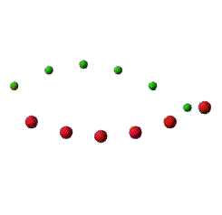

The motions of the two types of atom for each branch at k → 0 (long wavelength)
Optical mode for long wavelength and small k, A_{m}/A_{M} = -M/m
The atoms vibrate against each other, the center of mass of the
unit cell in the crystal remains fixed.
Acoustic mode for long wavelength and small k, A_{m} =A_{M}
Atoms and their center of mass move together.
http://slideplayer.com/slide/9413111/
Notes:
For the acoustic branch, the two atoms in the cell have the same amplitude and the phase. Therefore, the molecule oscillates as a rigid body.
For the optical branch, the optical oscillation takes place in such a way that the center of mass of a molecule remains fixed. The frequency of these vibrations lies in infrared region which is the reason for referring to this branch as optical.

Slide 36
Derivation of the motions of the two types of atom for each branch
Recall the equation of motion for the ionic crystal structure previously discussed,
The relative motion between m and M with a small k can be found when suitable frequency for each branch is considered.

Slide 37
Optical branch
Using one of the two equations from the matrix
For k = 0 →
The relative motion is found to be
Acoustic branch
Using one of the two equations from the matrix
For k = 0 →
The relative motion is found to be
Notes:
For acoustic branch, So in this limit the two atoms in the cell have the same amplitude and the phase.

Slide 38
Example 5
Absorption of infrared radiation by ionic crystal
Suppose the ionic crystals composed of ions of opposite charges ±e move under the influence of the electric field E = E₀exp(iωt).
The equations of motion can be written as
Appropriate displacement for each ion is given as follows

Slide 39
However, the analysis can be simplified by neglecting the wave number k if we consider the situation at a longer wavelength.
Assuming that the electric field is infrared and its wavelength is around 10⁻⁴ m.
This gives the wave number k ≈ 6×10⁴ m⁻¹. This value is negligible when comparing to the k_{m} which is the limit of wave number at the boundary of 1st Brillouin zone. Approximately, k_{m} is found to be π/2a where a = 10⁻¹⁰ m.
Under the assumption, this can simplify the equations of motion for each ion to be

Slide 40
The amplitudes for both ions are found to be
Where
When ω=ω₀, the ions amplitude increases meaning a strong absorption by ionic crystals
This actually is the low k limit of the optical branch.

Slide 41
Homework #6

